Slide 1


Gun Background Check
Kouamé Kouassi

Slide 2

Project Overview
Diagram File
Sources
ETL process
PostgreSQL
Flask app
JS Libraries
HTML & CSS#
Website Navigation
This Photo by Unknown Author is licensed under CC BY-SA

Slide 3


Project Overview
In this project, I will analyse the Gun background check of in the United States from 2016 to 2022. The analysis aims to detect the state where most firearm permits are issued and where you have the most control over those permits. In addition, several other factors that influence the carrying of firearms and the need for monitoring their proliferation in the different states of the USA will be analysed. Examples of factors can be:
the level of education
The number and rate of deaths caused by firearms
The average income level for families
The gun homicide committed by the three largest groups per state in the US; Black, White, Hispanic

Slide 4












Diagram
Start
End

Slide 5


File Sources
GitHub - BuzzFeedNews/nics-firearm-background-checks: Monthly data from the FBI's National Instant Criminal Background Check System, converted from PDF to CSV.
https://www.kff.org/other/state-indicator/firearms-death-rate-by-raceethnicity/?currentTimeframe=0&sortModel=%7B%22colId%22:%22Location%22,%22sort%22:%22asc%22%7D
https://www.cdc.gov/nchs/pressroom/sosmap/homicide_mortality/homicide.htm
https://worldpopulationreview.com/state-rankings/educational-attainment-by-state
The website I scraped: https://fred.stlouisfed.org/release/tables?rid=249&eid=259515#snid=259516
The CSV files used are from different sources and have different sizes. I have a large file from GitHub with more than 4000 rows and 3 small files for the factors affecting the Gun background check.
Concerning the web scraping, I have obtained data relating to the household median income for years ranging from 2015 to 2021.

Slide 6
ETL process
4 CSV files from 4 different sources
Scrape the economic data from St.Louis FED
Extract
Transform
Data cleansing and data merging on Jupyter Notebook using Pandas
Load
I Loaded 5 files in PostgreSQL
Convert Data
I also converted and exported the Dataframes in 5 Json files to use in the javascript’s plots

Slide 7
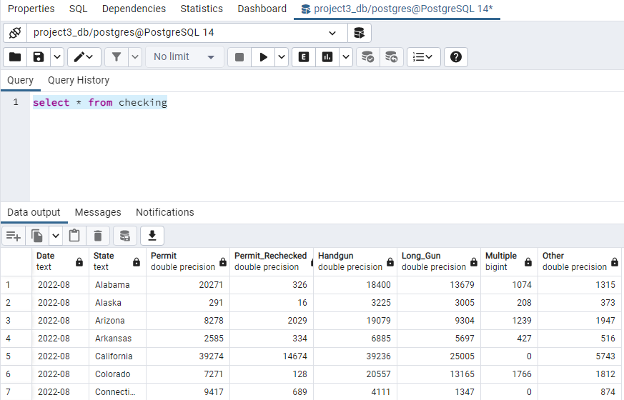
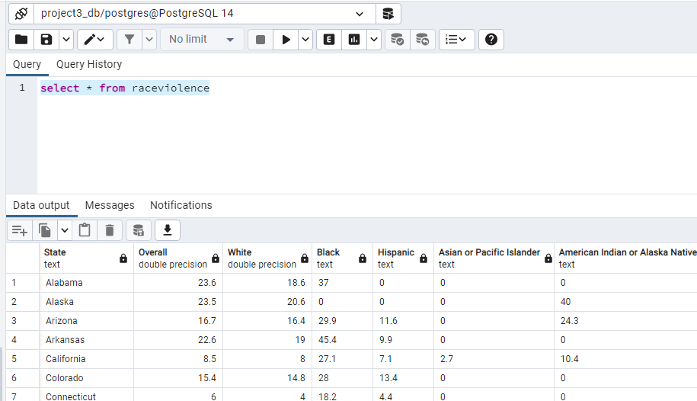
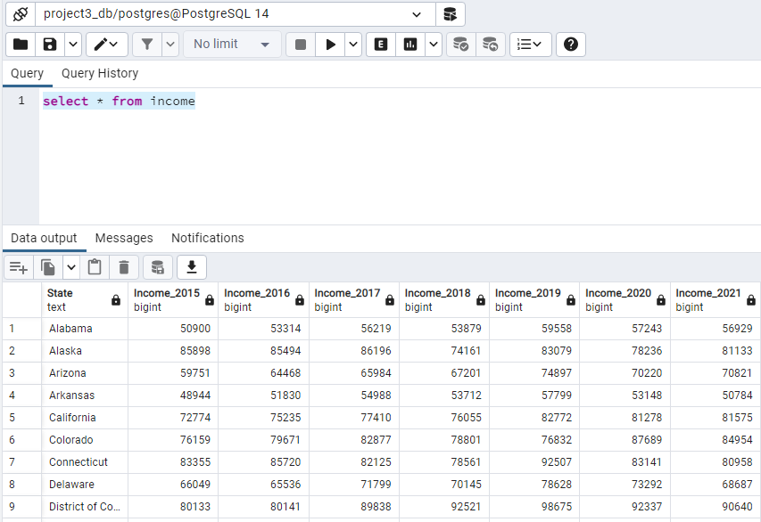
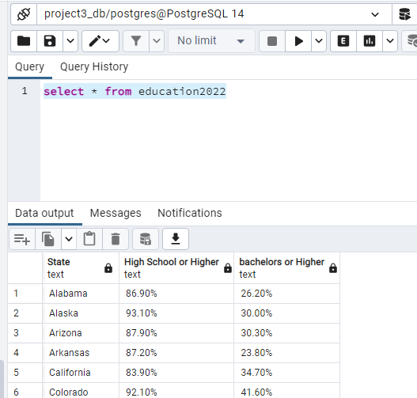
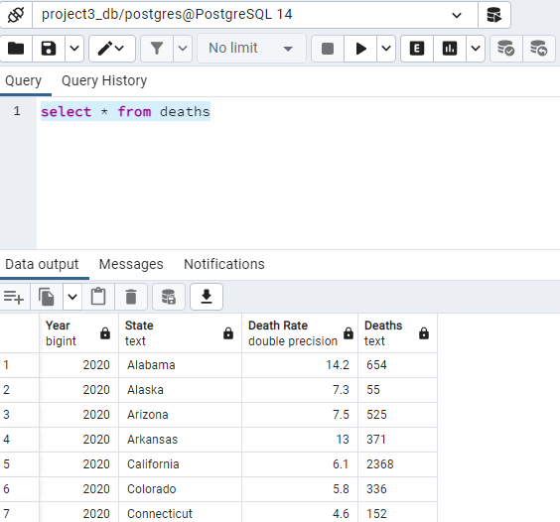
Loading on PostgreSQL

Slide 8

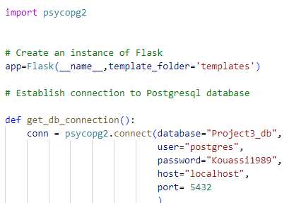
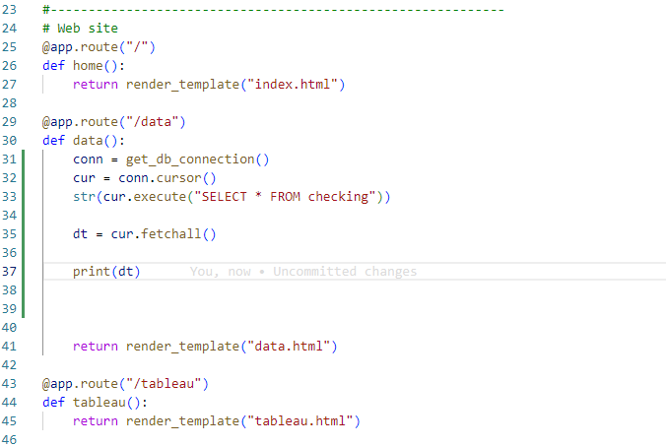
Flask app

Slide 9
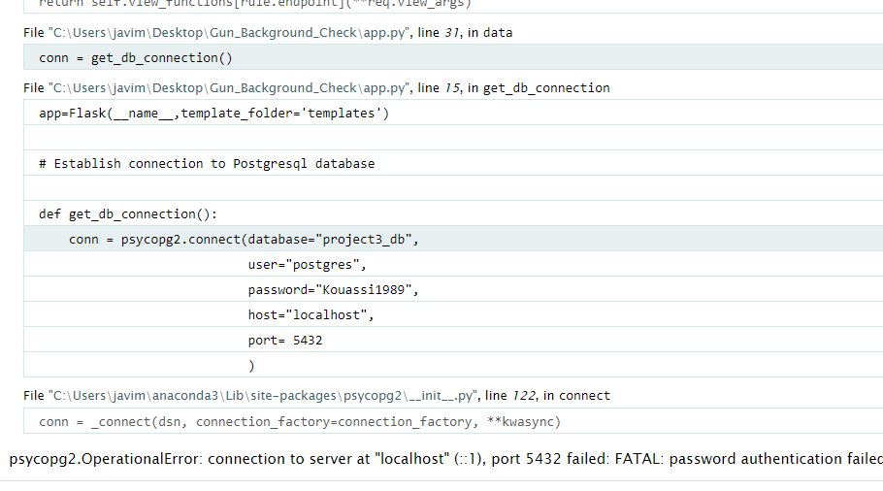
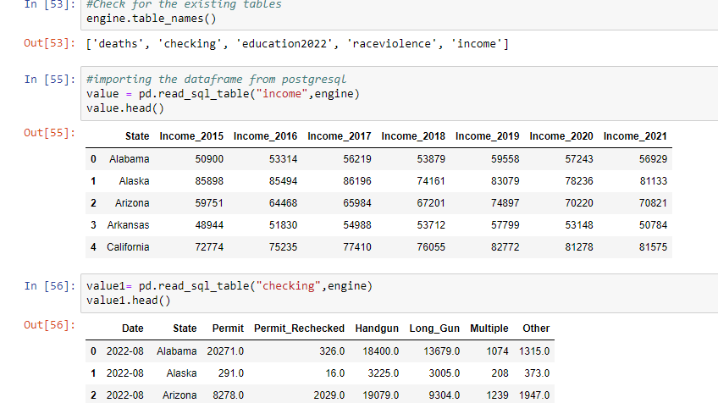
I was unable to connect to the database using Flask. However, the connection is possible on jupyter.The screenshots below highlight my claims.

Slide 10
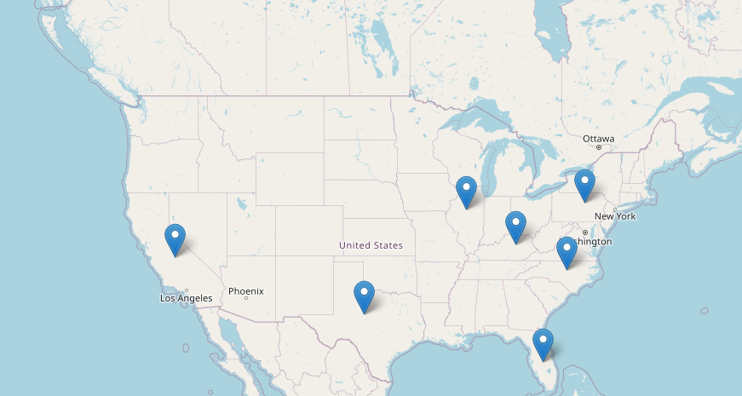
JS Libraries
I used leaflet to mark the position of the State with more Gun permit and their current population.

Slide 11

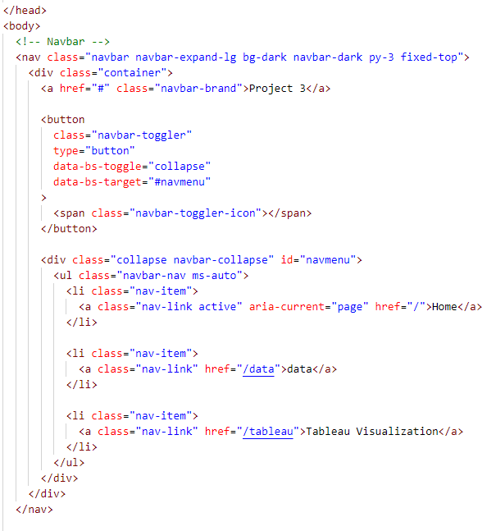
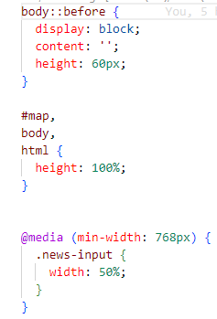
HTML & CSS

Slide 12
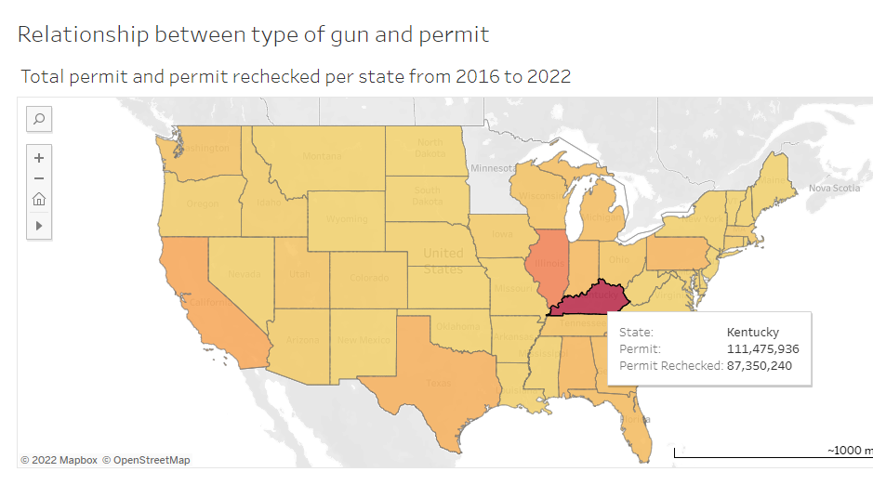
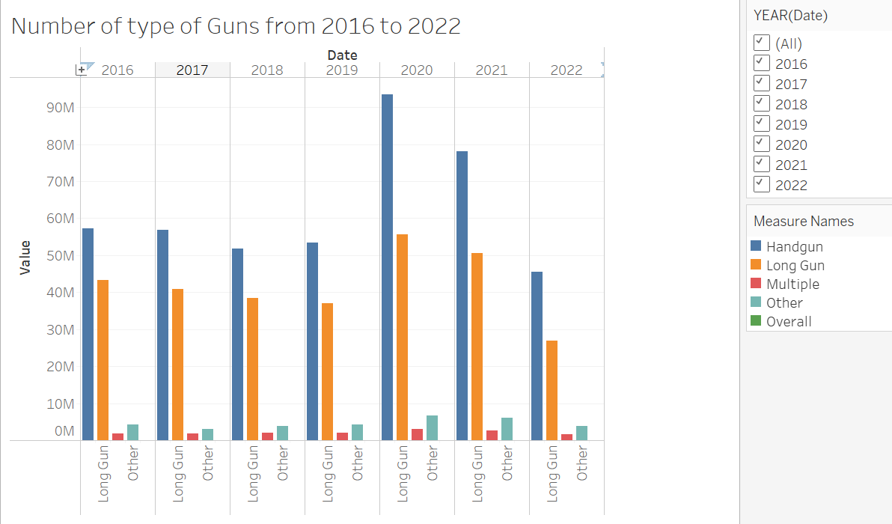
Tableau Visualisation
The map shows the states with the number of permits granted and The permit rechecked. In this view, Kentucky is the state with the most permits issued. The bar chart below represents the totality of types of Guns present in the USA from 2016 to 2022.

Slide 13
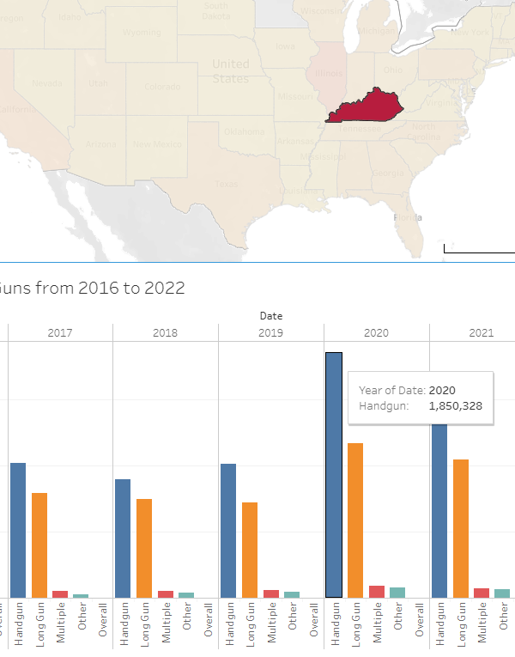
I created a relationship between the permits/permits rechecked in different states and the totality of firearms in circulation in each state between 2016 and 2022. For example, if I click on a map state, the bar graph gives me the total of types of weapons present in that specific state in the years considered.
In fact, in 2020 there were nearly 2 million Handguns circulating in Kentucky

Slide 14
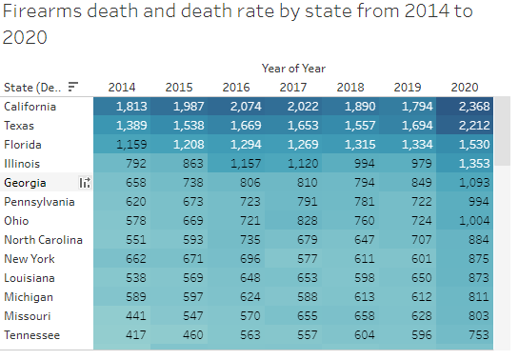
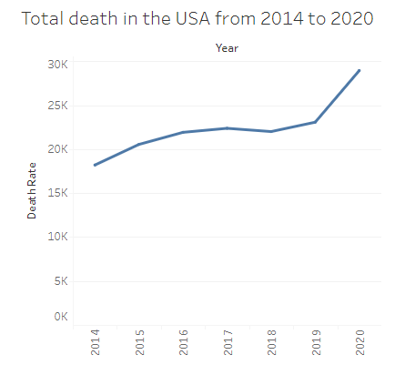
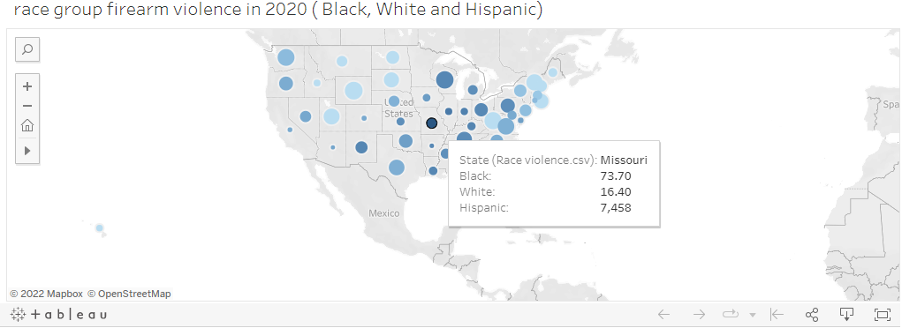
the table highlights the states where the most gun homicide were committed from 2014 to 2020.
In this line graph, it can be seen that the number of deaths from firearms in the USA between 2014 and 2018 had a relatively increasing curve. From 2018 to 2019, the average growth was under 25 thousand deaths, and then the number of death grew drastically between 2019 and 2020.
This visualization showcases the violence perpetuated by the 3 major races in the united states (Black, White, Hispanic) as reported by the Henry J. Kaiser Family Foundation

Slide 15

Inconsistency of the dataset
Re-structuring of the initial idea,
PostgreSQL connection issue
Struggle with JavaScript plotting
No expert of web development
Find some professional visualizations with tableau
The annual reference interval is not followed. This was caused by the absence of a good database
I can open properly the webpage with “Python app.py”, however the webpage is displayed properly when I use “ python –m http.server”.
I can only display the website if the files (Html, js) are in the same folder
I worked alone for this project.
Find more at the next page

Slide 16
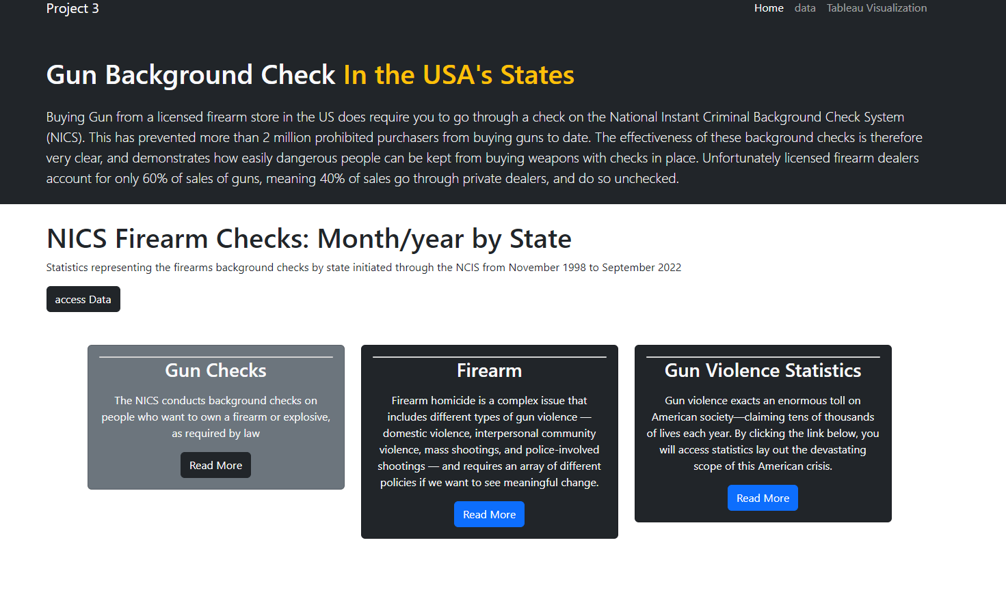
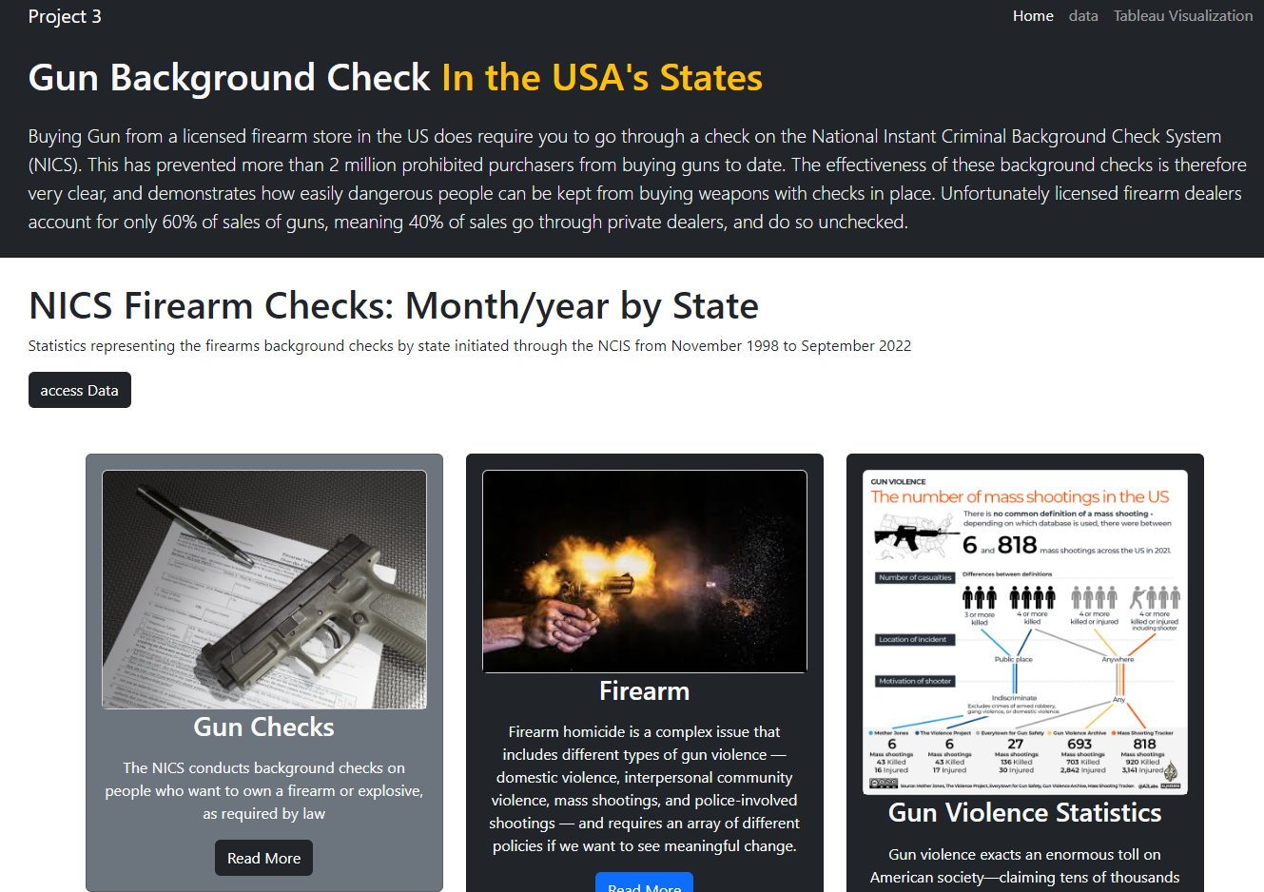
Visualisation using “python app.py”
Visualisation using “python –m http.server”
vs

Slide 17

Website page Navigation
On the Home page, we have a series of news regarding gun background checks, firearm homicide and gun violence statistics. Each article has a read-more that will direct visitors to the complete report for more information. There is also an ABC NEWS Youtube video about the US firearms epidemic.
The data page shows the leaflet map with the states with more Gun permit and their current population. There is also an incomplete attempt to generate some graphs with javascript.
The tableau page shows instead the visualisations that I embedded from my tableau public account.

Slide 18

THANK YOU

